Slide 1

Data Structures
Lecture 6: Stacks

Slide 2


Stacks
Stacks are abstract data structures (ADT) with the property that only the top element is accessible.
Stacks are based on the LIFO (Last-In-First-Out) principle.
They are severely limited compared to lists and vectors.
Applications: compilers. Undo/redo.

Slide 3






Stack Functions
Function | Behavior
 | Returns true if the stack is empty; otherwise, returns false.
 | Returns the object at the top without removing it.
 | Removes the object at the top of the stack.
 | Pushes an item onto the top of the stack.
 | Returns the number of items in the stack.

Slide 4
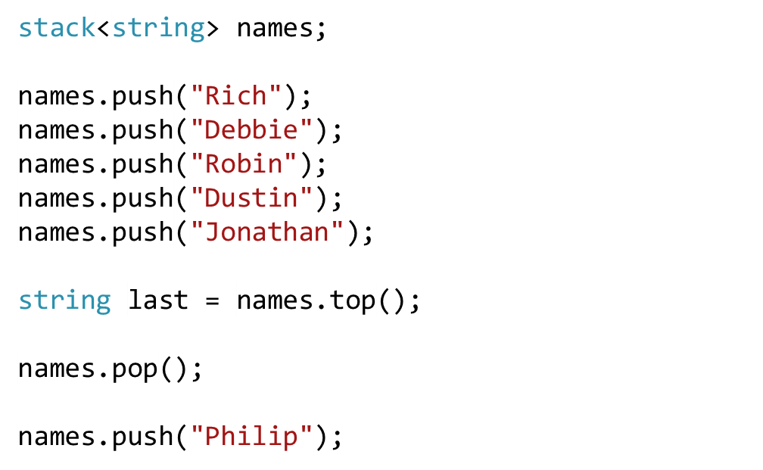
Stack Example
Philip
Jonathan
Dustin
Robin
Debbie
Rich

Slide 5
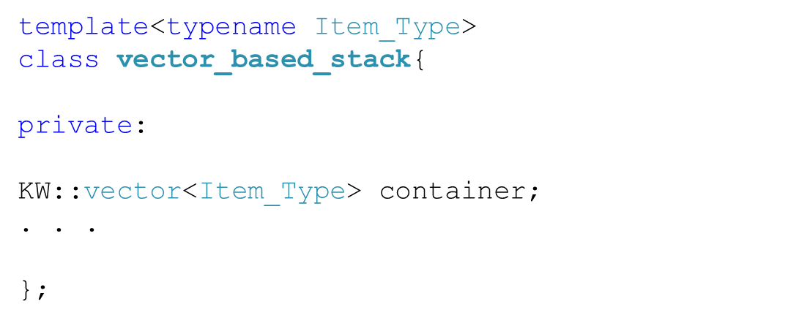
Implementing Stacks Using Vectors (1)
The stack uses a vector for storage of the stack data.

Slide 6
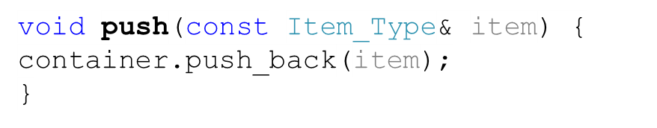
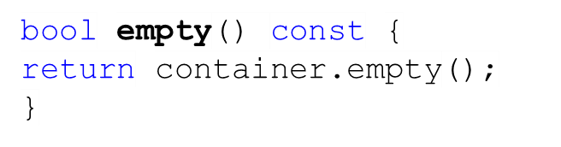
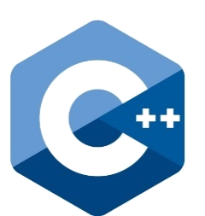
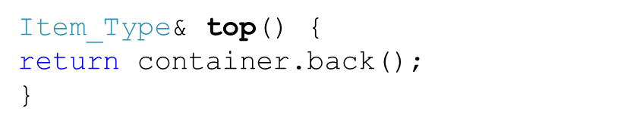
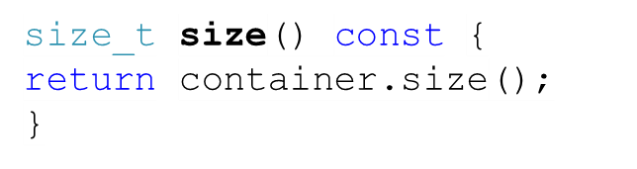
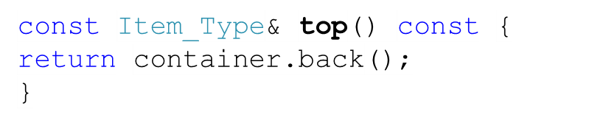
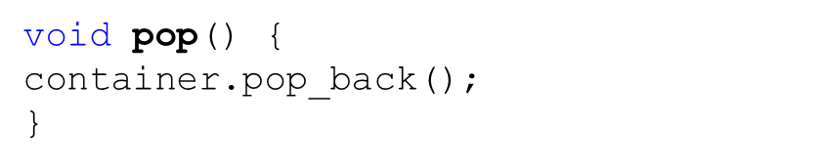
Implementing Stacks Using Vectors (2)
All the functions are O(1) on average.
However, there is a space problem whenever we overload the array behind the vector.
Could we have used push_front and pop_front ?

Slide 7
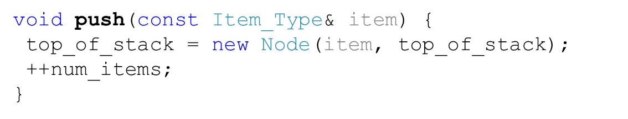
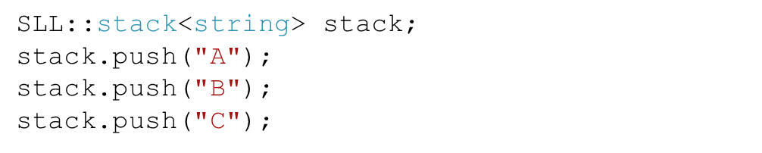
Implementing Stacks Using Linked Lists (1)
We can build a stack using a singly-linked list.
stack
top_of_stack=
num_items= 0
1
2
3
Node
Node
Node
Next=
Data=“C”
Next=
Data=“B”
Next= NULL
Data=“A”

Slide 8
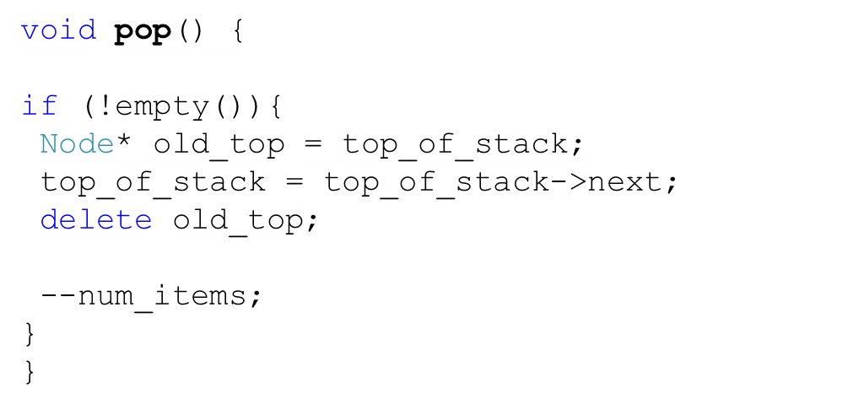
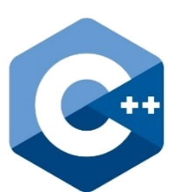

Implementing Stacks Using Linked Lists (2)
stack
top_of_stack=
num_items= 0
1
2
3
Node
Node
Node
Next=
Data=“C”
Next=
Data=“B”
Next= NULL
Data=“A”
Could we have used a doubly-linked list?
It would have been a bad choice since we wouldn’t use the extra backward references.
We get an O(1) performance with a singly-linked list.

Slide 9
Finding Palindromes (1)
A palindrome is a string that reads the same in either direction: left to right or right to left.
Example: “I saw I was I”.
Steps
1. Push the characters of the string in a stack.
2. Construct a string using the popped characters from the stack
3. Compare the constructed string against the original string

Slide 10
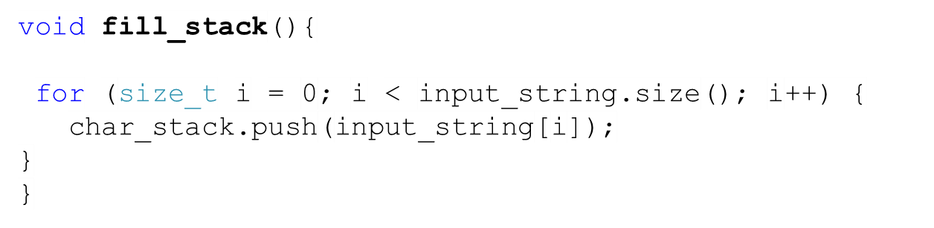
Finding Palindromes (2)
I
“I saw I was I”.
s
a
w
I
w
a
s
I

Slide 11
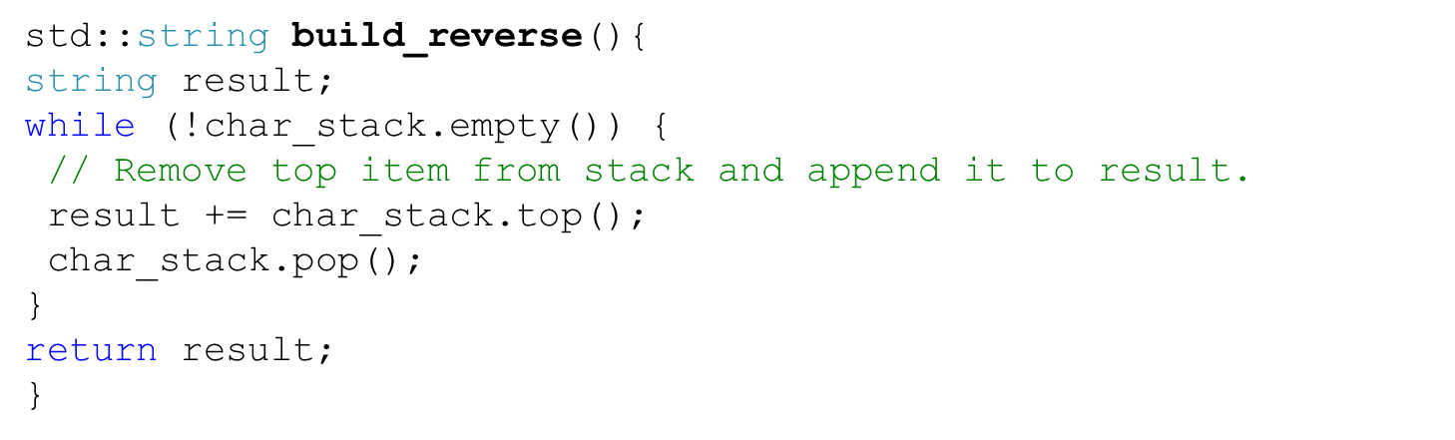
Finding Palindromes (3)
I
“I saw I was I”.
s
a
w
I
w
a
s
I

Slide 12

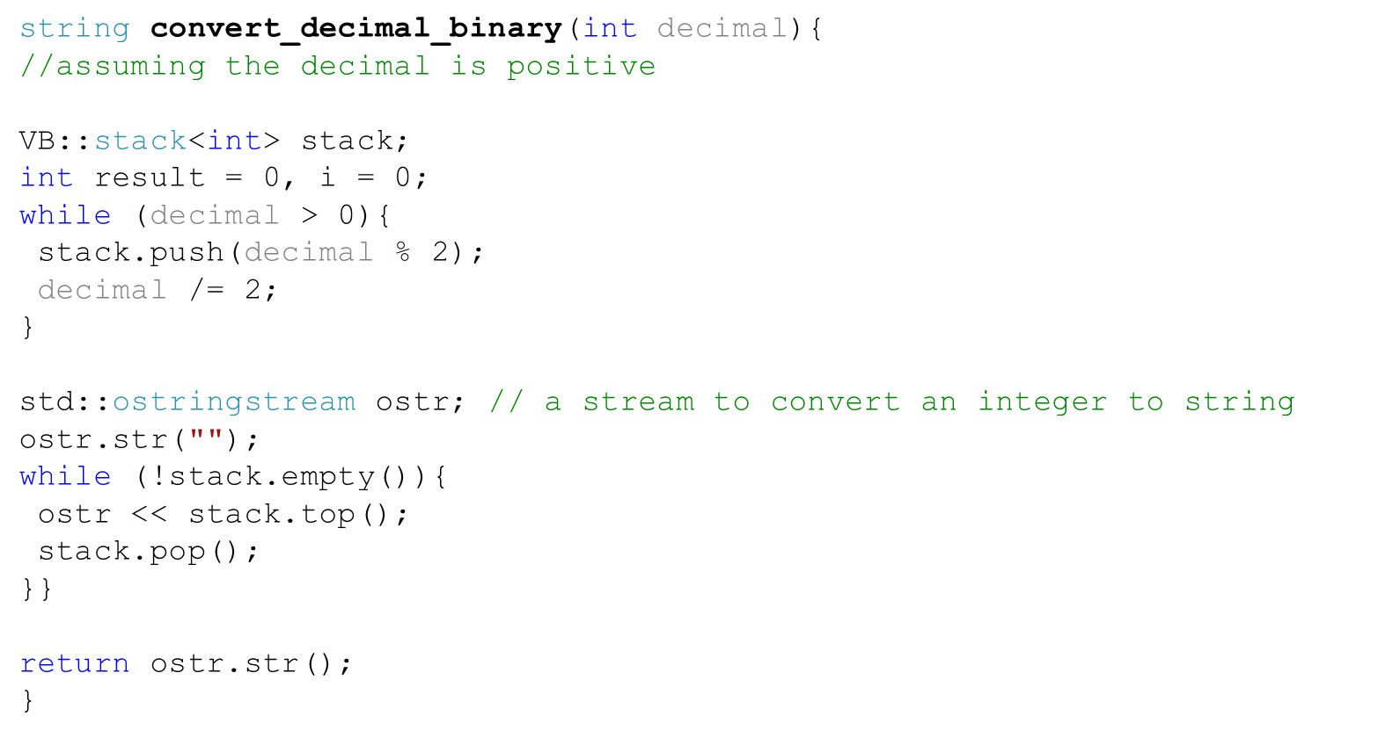
Task
Not in the book
Using a stack, write a function that converts a number from decimal form to binary form. For instance, 4d=100b
Converting 4
1
0
0

Slide 13
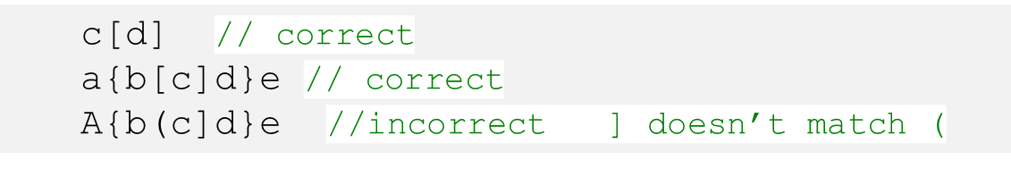
Testing Expressions for Balanced Parentheses (1)
For opening delimiter should by matched by a closing or right delimiter.
Solution
Parse the expression, push the opening delimiter on the stack
As we are parsing, when we find a closing delimiter, we compare the top of the stack with the closing delimiter, and pop it.

Slide 14

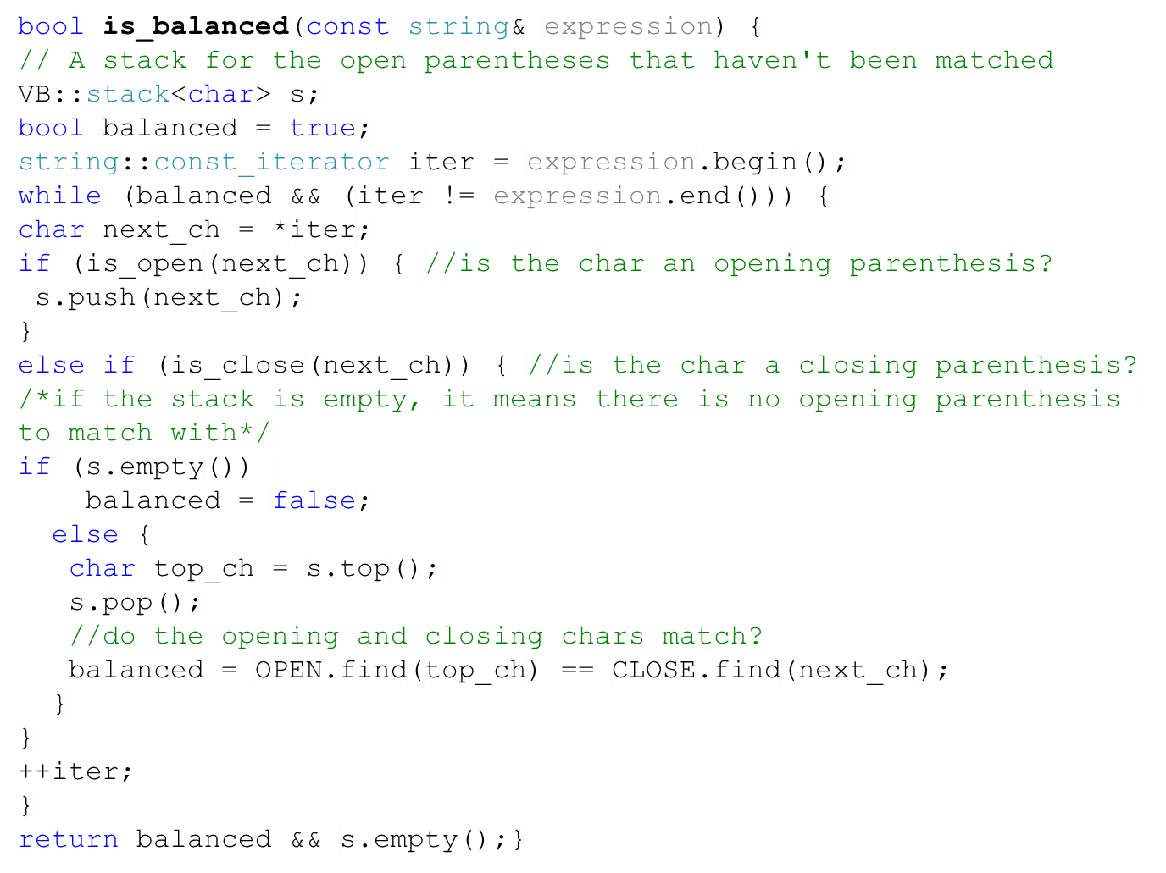
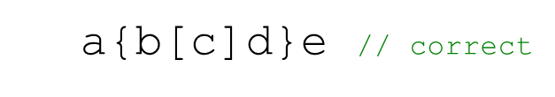
Testing Expressions for Balanced Parentheses (2)
[
]
{
}

Slide 15

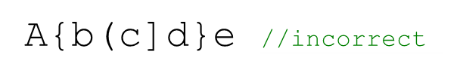
Testing Expressions for Balanced Parentheses (3)
(
]
{

Slide 16
Task
Not in the book
A lot of software applications provide undo and redo functionalities. They store the actions the user wants to undo or redo. For instance, the user could carry out these actions in a sequence: (1) Add a circle (2) Add a triangle (3) Add a rectangle. If the user clicks undo, the system will remove the rectangle that has been added. Clicking undo again removes the triangle. Clicking redo adds the triangle.
  1. What abstract data structure would you use to model the undo/redo functionalities? Why?
  2. Draw a class diagram that shows the main concepts of the problem and the relationships between them.
  3. Write functions for the following:
    a. A function to perform the user’s actions (this function will be typically run when the user carries out an action).
    b. A function for undo.
    c. A function for redo.

Slide 17
Solution (1)
Not in the book
We have two stacks: one for the undo actions, and another for the redo actions.
Stack
<String>
2
1
ActionHistory

Slide 18
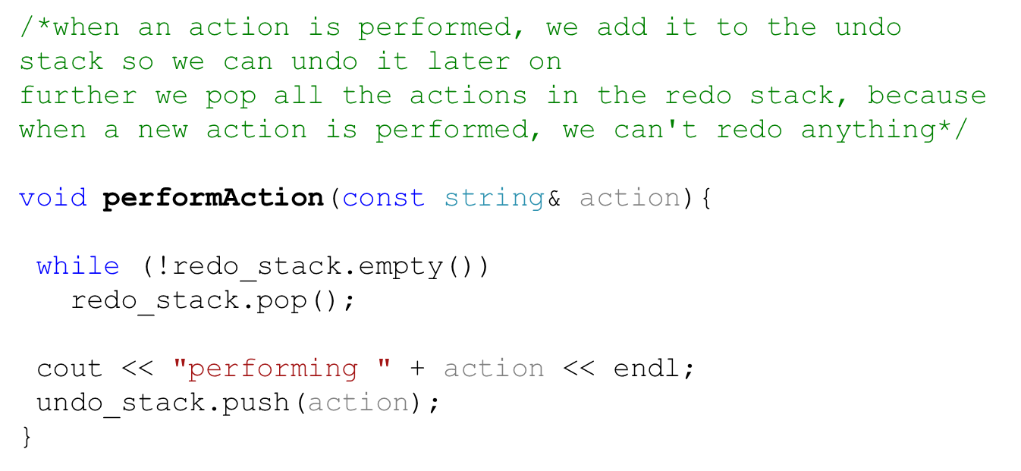



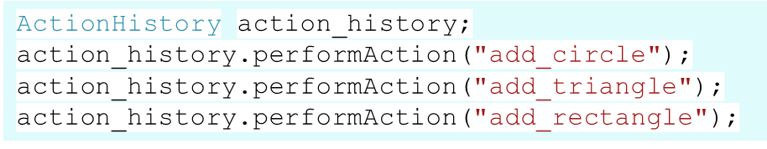
Solution (2)
Not in the book
add_rec
add_tri
add_circle
Redo stack
Undo stack

Slide 19
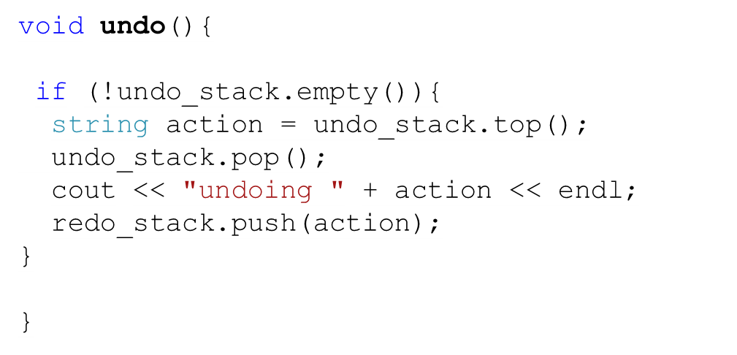

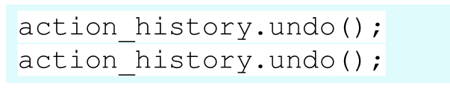
Solution (3)
Not in the book
add_rec
add_tri
add_tri
add_rec
add_circle
Redo stack
Undo stack

Slide 20
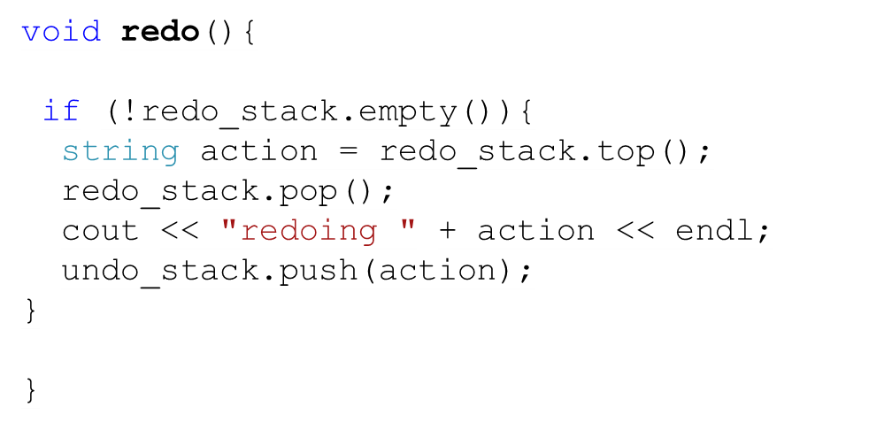
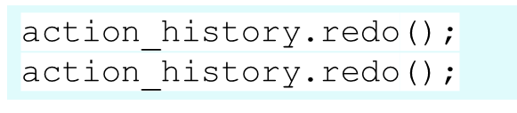
Solution (4)
Not in the book
add_rec
add_tri
add_tri
add_rec
add_circle
Redo stack
Undo stack

Slide 21
Arithmetic Expressions
Arithmetic Expressions consist of operands and operators.
There are three types of them:
1. Infix expressions: a*b
2. Postfix expressions: ab*
3. Prefix expressions: *ab

Slide 22
Evaluating Arithmetic Expressions
Postfix | Infix | Value
4 7 * | 4 * 7 | 28
4 7 2 + * | 4 * (7+2) | 36
4 7 * 20 - | (4*7)-20 | 8
3 4 7 * 2 / + | 3+((4*7)/2) | 17

Slide 23
Advantages of Postfix Expressions
No need to use parentheses for grouping.
No need to use precedence rules
Meaning of this infix expression: a + b*c =
a + (b*c)
* and / have higher precedence than + and - .
For a + (b*c), postfix is
abc*+
  For (a+b)*c, postfix is:
  ab+c*

Slide 24
Evaluating Postfix Expressions (Algorithm)
28
while there are more tokens
Get the next token
if the first character of the token is a digit
Push the integer onto the stack
else if the token is an operator
Pop the right operand off the stack
Pop the left operand off the stack
Evaluate the operation
Push the result onto the stack
Pop the stack and return the result
  4 7 * 20 -
20
7
4*7
28-20
4
28
8

Slide 25
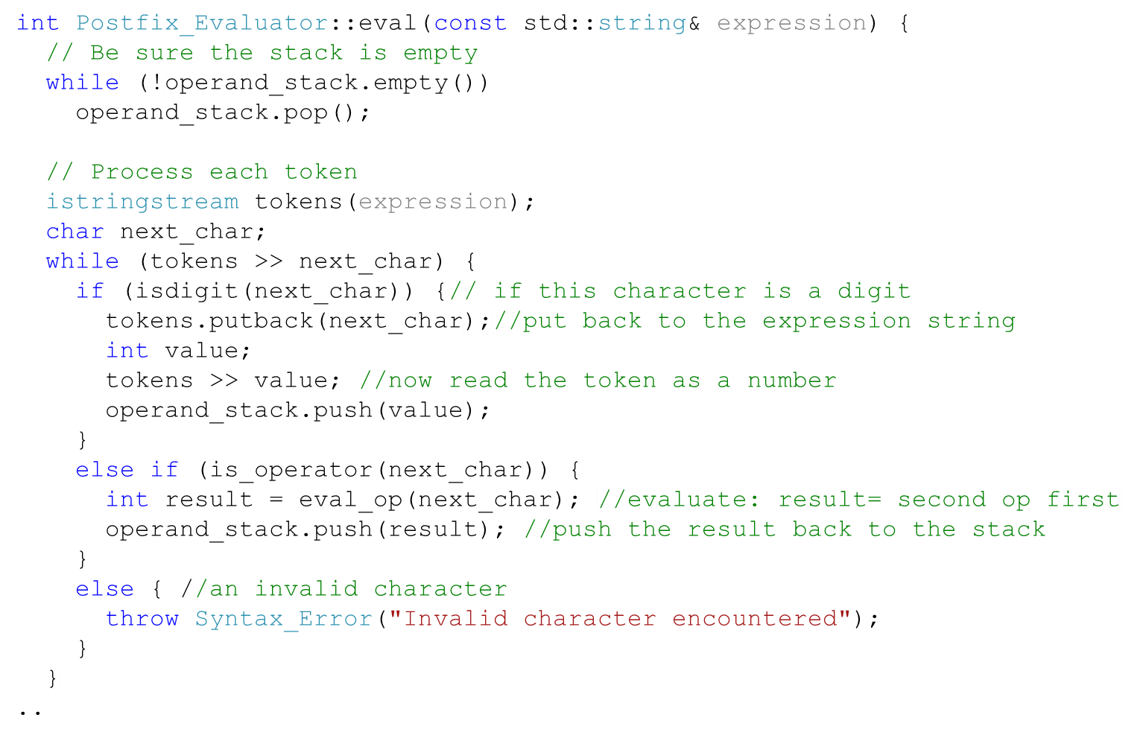
Evaluating Postfix Expressions (Code) - 1
28
  4 7 * 20 -
20
7
4*7
28-20
4
28
8

Slide 26
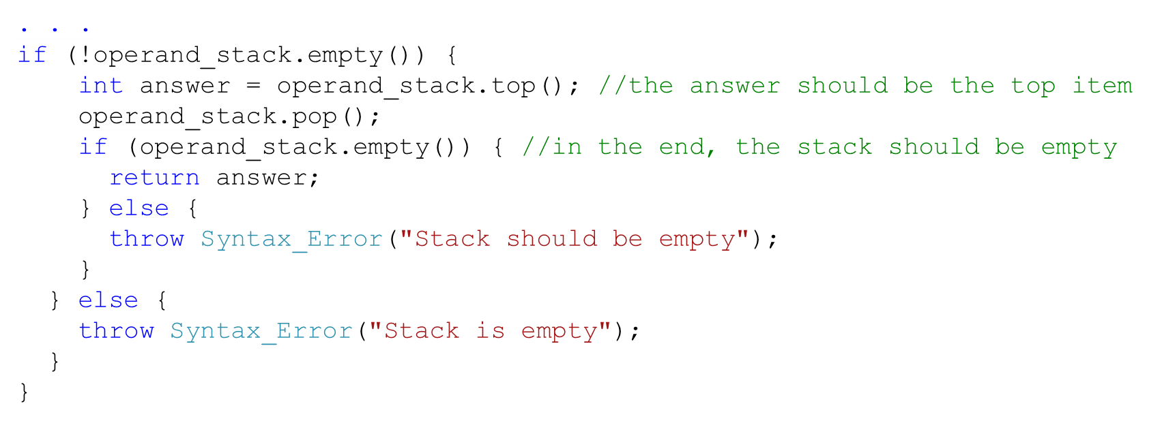
Evaluating Postfix Expressions (Code) - 2

Slide 27
Task
Not in the book
Write an algorithm that uses a stack(s) to evaluate a prefix expression. For instance, the algorithm might take as a parameter (- 10 + / 15 5 3), and the result will be 4

Slide 28
Converting from Infix to Postfix
Algorithm
  w – 5 / a * 2
while there are more tokens in the infix string
Get the next token
if the next token is an operand
Append it to postfix
else if the next token is an operator
while the stack is not empty & prec(new) ≤ prec(top)
pop top off stack and append to postfix
Push the new operator
else
Indicate a syntax error
Pop remaining operators off the operator stack and append them to postfix
*
/
-
w
5
a
/
2
*
-
Infix: w - ((5/a) * 2)
Postfix: w 5 a /2* -

Slide 29

Converting Expressions with Parentheses to Postfix
Algorithm
  ( a + b * ( c + d ) )
while there are more tokens in the string
Get the next token
if the next token is an operand
Append it to postfix
else if the next token is an operator
if (operator is ( || prec(new) > prec (top)) push it
else
while the stack is not empty & prec(new) ≤ prec(top) & top!=opening parenthesis
pop top off stack and append to postfix
if operator is a closing parenthesis
if(stack is empty) repot error
compare it with the parenthesis on top of the stack, if it matches, pop it
else Push the new operator
….
+
(
*
+
(
a
b
c
d
+
*
+

Slide 30
Task
Not in the book
Using stacks show how you would convert the following infix expression into a postfix expression:
2 – 3* ( ( 2 – 1 ) / 5 )
-
(
)
/
(
)
*
-
2
3
2
1
-
5
/
*
-

